Slide 1
Analysis on Admitted patients
Shonil Dabreo

Slide 2
Analysis on Admitted patients
Introduction
Problem Statement
Data
Descriptive Statistics and Visualization
Hypothesis Testing
Discussion
References

Slide 3
Introduction
Admitted patients are patients who undergo a public or private hospital’s formal admission process to receive treatment and/or care. The details of the admitted patients are recorded which include their No of overnight stays, Type of the hospital, Name of the hospital, etc.
The problem is to understand the statistical difference in the average length of stay (days) between large and medium hospitals.
Statistics is undertaken to compare the difference in the average length of stay (days) between both hospitals. The results of the statistics are interpreted by which patients might choose one hospital over the other.

Slide 4
Problem Statement
The goal is to understand if there is any statistical significant difference in the average length of stay (days) between large and medium hospitals which might make patients choose one over the other.
The problem is established by assuming a null hypothesis that the mean average length of stay (days) for large hospitals is equal to the mean average length of stay (days) for medium hospitals.
T-tests are statistical hypothesis tests which is conducted to test if the hypothesis is plausible.

Slide 5
Data
Data preprocessing is extremely important because it allows
improving the quality of the raw experimental data. The primary
aim of preprocessing is to eliminate those small data contributions
associated with the experimental error.
Data Cleaning is one of the Data preprocessing step for collecting
and preparing the data.
Steps of Data Cleaning:-
Eliminating records or attributes with missing values
Identify and remove outliers
Feature Engineering

Slide 6
Data
Eliminating records or attributes with missing values
The data is noisy which contains the textual information about the data source. This textual information is removed (i.e. skipped) while retrieving the data.
There are certain attributes which contains missing values in all the rows. These attributes are ignored by selecting attributes which includes some values in it.

Slide 7
Data
Identify and remove outliers
The average length of stay (days) attribute includes NP values (i.e. Reported
values which didn’t meet the criteria).
The NP values include criteria where patients reported deaths or transfers to
another hospital. Therefore, Replacing NP values with any constant value would
be illogical. The NP values could be assumed as outliers.

Slide 8
Data
Identify and remove outliers
The total count of NP values is calculated by filtering the NP values from average length of stay (days) attribute.
The average length of stay (days) attribute is converted to numeric. This changes all the NP values to NA (i.e. Not Applicable) values.
These NA values are then ignored by filtering average length of stay (ALOS) attribute values which are other than NA values.

Slide 9
Data
Feature Engineering
The attributes of interest are selected to calculate the statistical information.
The ‘average length of stay (days)’ and ‘Peer group’ are the attributes which are selected to perform the statistics.
‘average length of stay (days)’ is calculated as the number of bed days for overnight stays divided by the number of overnight stays.
‘Peer group’ is the type of hospital where patients were admitted such as Major hospital, Large hospital, Medium hospital, Children’s hospital, Small hospital and Unpeered.

Slide 10
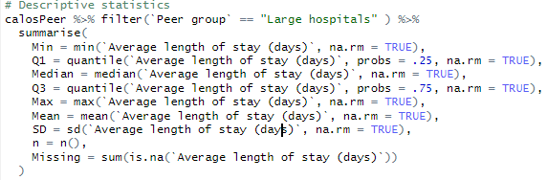

Descriptive Statistics and Visualization
Descriptive Statistics
Descriptive statistics of average length of stay (days) in Large hospitals is calculated by filtering the average length of stay (days) based on Peer group ‘Large hospital’.
Code
Output

Slide 11
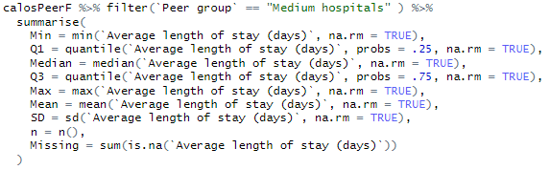

Descriptive Statistics and Visualization
Descriptive Statistics
Descriptive statistics of average length of stay (days) in Medium hospitals is calculated by filtering the average length of stay (days) based on Peer group ‘Medium hospital’.
Code
Output

Slide 12

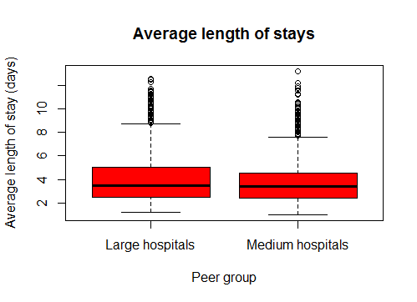
Descriptive Statistics and Visualization
Visualization
Code
Output

Slide 13
Descriptive Statistics and Visualization
Visualization
Box plot of the average length of stay (days) in Large hospitals and Medium hospitals is plotted for visual analysis.
Looking at the output, we can say that the mean of average length of stay (days) in Large hospitals is greater than the Medium hospitals.
Many patients have similar average length of stay (days) in Large hospitals in certain parts of the scale which is Quartile group 3. But in other parts of the scale the average length of stay (days) of patients are variable.
The outliers are visible from the upper whisker which are separately shown as plotted points.

Slide 14
Hypothesis Testing
Null Hypothesis is an assumption on which statistical T-test is computed to find
out if the plausible hypothesis is true or not.
Null Hypothesis (H0 = 0):
Mean of average length of stay (days) in large hospitals is equal to the mean
of medium hospitals.

Slide 15
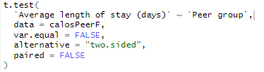
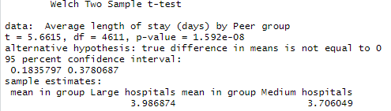
Hypothesis Testing
Code
Output

Slide 16
Hypothesis Testing
T-test is conducted and result of the t-test for hypothesis is displayed.
t is the t-test statistic value which is 5.6615
df is the degrees of freedom which is 4611
p-value is the significance level of the t-test (p-value = 0.0001592).
conf.int is the confidence interval of the mean at 95% ( [0.1835797, 0.3780687]);
sample estimates is the mean value of two independent samples (mean = 3.986874, 3.706049).
Interpretation:
The p-value of the test is 0. 0001, which is less than the significance level
alpha = 0.05. Therefore, Null hypothesis is rejected.
Thus, it can be concluded that mean of average length of stay (days) in large
hospitals is significantly different than the mean of medium hospitals.

Slide 17
Discussion
The mean of average length of stay (days) in large hospitals is greater than the mean of average length of stay (days) medium hospitals.
The degree of freedom is higher which means more power to reject a false null hypothesis and find a significant result
The limitation is that the outliers were removed for t-test hypothesis testing.
As a result, we can say that patients might choose Large hospital over the Medium hospital.

Slide 18
References
Science direct. Data Pre-processing [online]. Available at
<https://www.sciencedirect.com/topics/engineering/data-preprocessing / > [Accessed 10 May 2020]

Slide 19
Thank You

